Slide 1
Creating an enabling environment for private sector investment in Malawi
16th Ndizotheka Eminent Speaker Series
Jonathan Said – Vice President Center of Technical Expertise – AGRA
April 2026

Slide 2
The bottom line
Malawi doesn’t lack potential & fundamentals in place —land, demand, private sector interest, dynamic youth & SMEs, policy ambition & plans
But transformation elusive: forex, tax base, underinvestment, low productivity
Gap not knowledge, it’s organization: since 1980s we don’t act collectively & consistently at national scale. Implementation & coordination struggle.
Malawi’s political economy prevents it
Question not whether Malawi can transform but how may it shift from fragmented, short-term efforts to sustained collective action
Approaches like Commodity Cluster Compacts provide a pathway:
align actors, structure deals, and expand opportunity.
(Proven in Tanzania, Kenya, Ghana, Ethiopia, Asia, Latin America)

Slide 3
Let’s start by looking into 2 high potential sectors in Malawi

Slide 4
Soybean
Demand & Opportunity
Cooking oil, animal feed, lecithin, soymilk, TSP/soy chunks, emulsifiers, bio-polymers, adhesives etc etc.
Large demand in Malawi & region & growing from oil processors, feed manufacturers and food industries
From sorrybean to soybean
Current Malawi installed processing capacity: ~850,000 MT
Imported cooking oil rising; $600m in forex import subst potential
Export opportunity: Tanzania & Kenya each only produce 20,000 MT per year!
Key for soil health restoration as it’s a legume
Scope for national production of at least 1 million MT per year
Supply Constraint & Risk
But farming system not supplying enough: ~190,000 MT produced in 2025 & national yield average only 0.8 tons/ha vs global standard of 3.0
Early generation seed of high oil varieties limited
Weak agronomy & farm management
2023 rust went unmanaged, cut production by over 50%
Limited use of fungicides & inoculant
Limited mechanization, especially for threshing
Side-selling
Export ban lobbying when concerned on supply
Processors fighting over a small pie, squeezing farmers

Slide 5
Groundnut
Demand & Opportunity
Peanut butter, snacks, peanut oil, baby food.
Demand is clear in region & globally & growing from foreign importers (e.g Zim)
Private investment in processing increasing
Current Malawi installed processing capacity: ~8,000 MT per year but scope for over 100,000 MT today
Scope to triple groundnut exports from $185m to $529m per year
Key for soil health restoration, legume
Scope for national production of at least 1 million MT per year
Supply Constraint & Risk
But farming system not supplying enough: ~350,000 MT produced in 2025 & national yield average only 0.9 tons/ha vs global standard of 2.0
Early generation seed of market-demanded, certified varieties limited
Weak agronomy & farm management
Aflatoxin issue unaddressed since 1980s (Pyxus/Nasfam moving on it)
Weak post harvest handling
Side-selling
Lack of irrigation
Very limited processing, relative to potential

Slide 6
Why Do Good Efforts Fail in Malawi?
An Honest Conversation
The Pattern We See
Various initiatives launched with ambition
Stakeholders mobilized and aligned—initially
Momentum builds… then fades over time
Why This Happens
Efforts focus on myopic, siloed projects— not systems & national strategy
Limited alignment with real market incentives
Fragmented interventions across actors and programs
Insufficient focus on sustaining collective action on binding constraints
Hard Truth
Public & development support has underestimated political economy
Too little focus on: incentives, champions, coordination, and long-term commitment
So progress remains incremental—not transformational
Collaboration, cross learning and coordination stalls

Slide 7
Malawi not alone, Africa faces similar reality
Africa has fundamentals for agricultural transformation
Abundant land (expansion + intensification)
Large, growing labour force
Rising domestic & regional demand
But systems struggle to convert potential to value
Weak end-to-end value chain coordination
Limited structured markets connecting production to markets
Policy/regulatory unpredictability
Political economy major challenge in most African countries
Missing Middle
Weak aggregation, logistics & high transport costs
Limited links to processors/off-takers
High cost of finance + services
Weak seed-processor linkage
Limited investment
Limited coordination to problem solve
Result
Suboptimal yields, production and investment
Low value capture & industrialization

Slide 8
A bit of evidence & theory to help break camel’s back

Slide 9
Global & African evidence unequivocal on what works
Morocco: Tourism, Agri & Agro-processing, Fertiliser, Automotives
Tunisia: Agriculture, Electronics, Tourism, Pharma, Automotives
Turkey: Agric & Agro-Processing, ICT, Horticulture
China: Textiles, Electronics, Plastics, Cars, Agri & Agro-Processing
Netherlands: Finance, Horticulture, Floriculture, Tourism, Electronics
Vietnam: Textiles, Electronics, Pharma, Automotives, Rice & Agro-Processing
Mexico: Maize, Agro-processing, Automotives, Electronics, Tourism Computers, Plastics
Cambodia: Rice & Agro-Processing, Textiles, Electronics, Automotives
Costa Rica: Carbon Sectors, Energy, Agri & Eco-Tourism
Bangladesh: Textiles & Garments, Electronics, Rice & Agro-processing
Colombia: Maize, Coffee, Electronics, Tourism, Automotives
India: Wheat, Rice Agro-processing, iCT, Business Services, Textiles, Electronics
Zambia: Soybean, Poultry, Wheat
Chile: Horticulture, Salmon, Wine Automotives, Electronics, Pharmaceuticals
Ethiopia: Wheat, Flowers, Soybean, Leather, Textiles, Pharmaceuticals
Brazil: Sugar, Soybean, Agri & Agro-Processing, Automotives, Airplanes
Cote d’Ivoire: Cashew
Mauritius: Sugar, Textiles, Tourism, Financial Services
Botswana: Livestock, Tourism, Diamonds

Slide 10
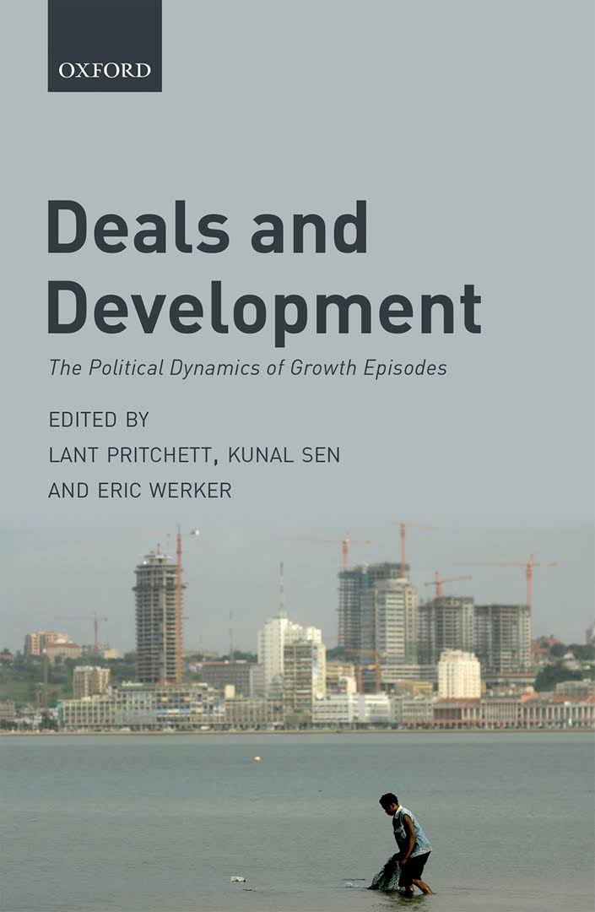

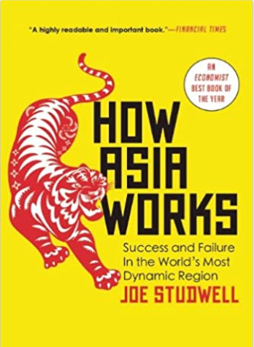
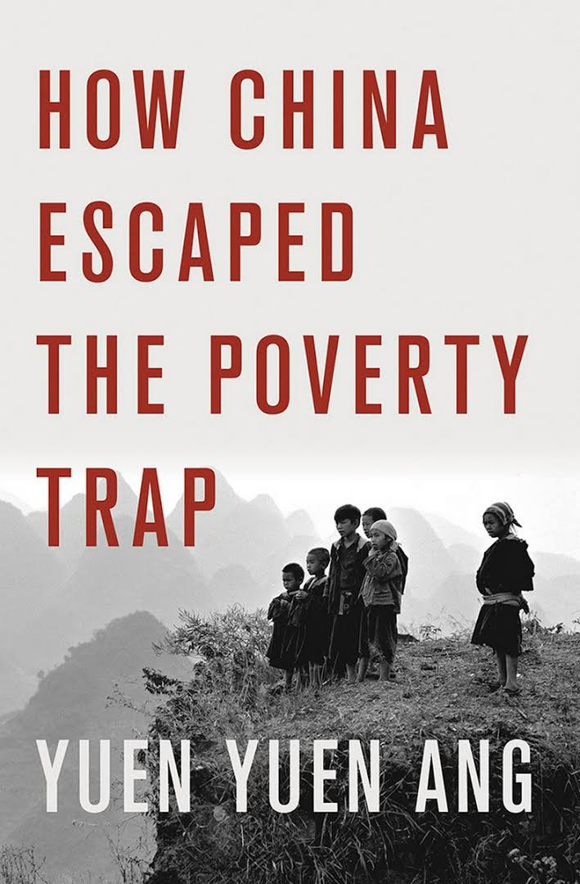
Bottom line driver of why coordination & co-learning stalls is political economy
Latest top global research captures the evidence:
Pritchett, Sen and Werker:
Long-term inclusive growth happens when political & business elites align for sustained time to develop key sectors
Stefan Dercon
Countries like Malawi and Nigeria have not achieved impact for political economy reasons, especially in agriculture & food.
Studwell: Asia transformed through collective action on land, market coordination, and financing, through modern industrial policy
Yuen Yuen Ang
The elite bargain was key for China to transform and pull hundreds of millions out of poverty, starting with an agri-food revolution.

Slide 11
For value chains to meet potential firms (inc smallholder farmers) must make money: this in linearity in VCs & supportive ecosystem
Supporting ecosystem
Trade policy
Trade facilitation
Typical Value Chain
Export products & markets
Domestic products & markets
Tax & regulatory obligations
Access to skills & education
Agro-processors
Access to information & digital solutions
Market linkages & post-harvest
Finance & business dev services inc for climate, women & youth
Private actors create jobs, & they think vertically, by value chain
Smallholder Farmer
Anchored to geo-spatial factors
Last mile extension & sustainable farming solutions
Access to mechanized solutions
Access to infrastructure (roads, energy, irrigation, wholesale markets)
Access to other inputs (water, fertilizer, inoculants, lime etc)
Inputs
Access to land
Seed system
Research & Development
Local community engagement

Slide 12
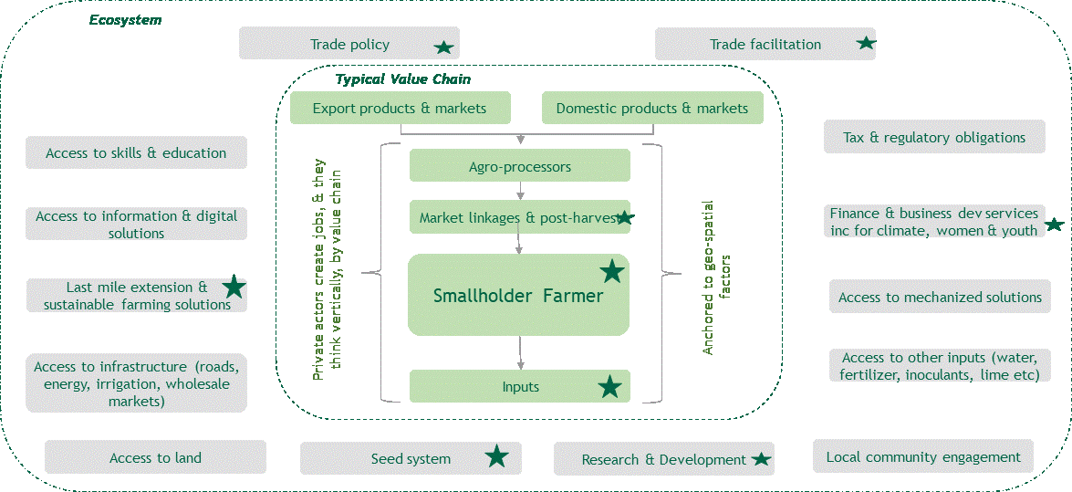
..& government needs to use modern agro-industrial policy to play its role
Government System
Ministry of Agriculture
President’s Office
National Planning
Ministry of Finance
Investment Agency
Ministry of Industry & Trade
Ministry of Gender & Youth
Ministry of Rural Development & Land
Ministry of Environment
Ministry of Health
Ministry of Education
Ministry of Energy
Most critical for policy coherence
Will typically follow if top 5 aligned

Slide 13
A political economy framing to understand why coordination stalls
Political Settlement
Rent Space
Private Sector Composition
National endowments (assets)
Deals Space
Global and regional factors
= does Growth and Structural Transformation happen over long term?

Slide 14
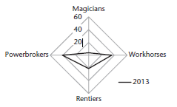
A political economy framing to understand why coordination stalls
Malawi, 2013
Rent Space
Private Sector Composition
Deals Space
Typical asks of political elites
Powerbrokers
Export bans, preferential licenses, happy with red tape, collusion, fight over small pie
Rentiers
Extraction infrastructure, enclave economies, subsidies
Powerbrokers – followed by rentiers - dominate , strengthening competitive clientelism of Malawi’s political settlement, so coordination for structural transformation fails long term
Magicians
Less red tape, collaborate with SMEs, state & ecosystem capacity & coordination strengthened, good infra
Workhorses
Less red tape, gov’t subsidies , state capacity strengthened

Slide 15
What can champions of change do

Slide 16
Way forward: unlocking collective action
The Reality
Gov’t, private sector nor partners can drive transformation alone
Markets do not self-coordinate
Fragmented actors → weak value chains
Drivers of transformation
Collective action for end-to-end value chain development among key actors with vested interest in their success:
Private sector (anchor firms, value chain private associations, processing, powerbrokers to magicians)
Government (policy, regulation, public goods)
Banks & local pension/savings: invest in high potential VCs chains
Development partners – support champions & capabilities through long term systems (e.g Soybean & Peanut Innovation Labs)
Missing Ingredient: Collective Action by the champions
Transformation driven by credible, invested actors
“Champions” to expand the pie, not “powerbrokers” competing over a small pie: Triple the pie, then triple it again!
Set shared vision: 1m MT soybean, 1m MT groundnuts
Challenge: enabling champions to focus on binding constraints to big pie shared vision
“If the problem is misaligned
incentives and fragmented actors,
then the solution is not
more traditional projects, it is structured
collective action.”
Role of the state
The state enables — not controls — transformation by:
Coordinating across actors and supporting alignment platforms, especially public-private dialogue and coordination
Aligning political and economic goals: long term tax revenue, forex & jobs
Support smart deals around anchor firms tied to shared vision
Predictable policy signals, reduce uncertainty & transaction costs

Slide 17
Commodity Cluster Compact - from fragmentation to positive deals that benefit the industry as a whole, inc smallholders
CCC is not just coordination — it is a DEALS platform
Aligns actors on shared vision: 1m MT sbean/gnuts
Anchored around real market demand
Processors define volume + quality
Aligns incentives across the system
Farmers → produce with certainty
Built around CHAMPIONS (not generic stakeholders)
Anchor firms
Serious investors
Committed public sector actors
These are the “magicians” who expand the pie
Creates “positive deals”
Reduces destructive competition
Aligns powerbrokers into a win–win growth agenda
Address fear of unknown
Structures supply, investment & finance
Moves from dialogue to manage investor risks
Farmers produce against guaranteed demand
Reduces speculative production
Banks → lend against structured demand
Input suppliers → invest with visibility
Government → supports coordination
Builds trust through mutual economic gain

