Slide 1
Redesigning the Affordable Inputs Program to Diversify and Sustain Growth
Christone J. Nyondo, William J. Burke, Milu Muyanga and William Chadza
Sunbird Capital Hotel - Lilongwe
February 24th, 2022

Slide 2
Why the subsidy program was introduced
Slow and erratic agricultural growth – averaging about 3% in the last decade
Frequent food insecurity,
Malawi ranked 81/116 countries on a Global Hunger Index (GHI) score
Low nutrition status
Undernourishment in the population still around 17%
High poverty rates – 51.5%
Notes:
The agriculture sector has been at the centre of the country’s economic development agenda since independence in 1964
However, the sector has been registering slow and erratic growth, averaging roughly 3% in the last 10 years
This 3% average growth rate is just half of the 6% sector growth considered necessary for any country to be food secure and self-sufficient and to have improved nutrition.
As a result, Malawi is still experiencing frequent food and nutrition insecurity issues despite making significant progress, since 2005
Food insecurity as measured by the GHI score is still classified as serious with a GHI score of 21.3% in 2021 and
Undernourishment in the population is still around 17%
The major factor contributing to low agricultural productivity has been cited as the inability of smallholder farmers to access adequate quantities of productivity enhancing farm inputs, such as inorganic fertilisers and seed.
The inputs subsidy program (FISP) was introduced to counter this problem
The program initially targeted between 0.9 to 1.6 million smallholder farmers before being made universal in the 2020/21 agricultural season when it was expanded to reach 3.7 million smallholder farmers
The program has made several achievements that has made it popular

Slide 3
Achievements of previous subsidy programs
Improved the total output of grain legumes
CG-7 groundnuts from roughly 900kgs/Ha to 1.12MT/Ha
Soya and Pigeon peas from roughly 800kgs/Ha to 1.22MT/Ha
Improved food security
The GHI score has dropped from 33.5% in 2006 to 21.3%
Improved child nutrition at household level
Low height for age (stunting) dropped from 52.5% in 2005 to 37%
Low weight for age (child wasting) dropped from 6.3% in 2005 to 2.7%
Thus, it has been maintained by successive administrations – with varying designs and scales of coverage
Notes:
For example, the APES data shows that farmer-level yields for CG-7 groundnuts increased from around 900kgs/Ha to around 1.12 MT/ha
And those for pigeon peas and Soybeans from around 800kgs/Ha to around 1.22 MT/Ha and 1MT/Ha, respectively
However, these were below their respective yield potential of 2.5MT/Ha for CG-7 groundnuts, 6MT/Ha for Pigeon peas, and 4MT/Ha for Soybeans
The GHI score has dropped from 33.5% in 2006 to 21.3% in 2021
Stunting - Low height for age - has dropped from 52.5% in 2005 to 37%
Child wasting - low weight for age - dropped from 6.3% in 2005 to 2.7%
Subsequently, the program has been maintained by successive administrations – with some variations in design and scales of coverage
As will be shown in the next slide, the program has been praised as a suitable and appropriate response to persistent food crises in the country

Slide 4
Achievements of previous subsidy programs
Lauded as a suitable and appropriate response to persistent food crises
Average household maize yields increased over 60% from 1.3 MT/ha (1995-2004) to 2.1MT/ha (2005-2014)
Yields are slightly lower and volatile to external shocks (e.g., rainfed as in 2015)
Source: APES and FAOStat
Notes:
As average household maize yields increased by over 60% from 1.3MT/ha between 1995-2004 to 2.1MT/ha between 2005 to 2014
However, these yields are not only lower than the moderate potential yields of 7MT/ha but also
Susceptible to external shocks such as rainfall as seen between 2015 and 2017
In the next slide I want to show you why previous subsidy programs may have underachieved

Slide 5
Why previous subsidy programs may have underachieved
Ineffective targeting of beneficiaries due to comingling of objectives
Displaced private sector commercial sells by 15 – 21% prior to 2020/21 season
Financially unsustainable – subsidy allocations averaging roughly 65% of MoA budget
Notes:
In subsidy programs like our AIP, subsidies are supposed to be rationed to poor but potentially productive beneficiaries who would otherwise lack access to commercial inputs (My colleague Jan will probably talk more about the complexities of targeted programs)
Ineffective targeting may reduce the cost-effectiveness of subsidies, the overall contribution of subsidies to total fertilizer use at farm-level, and/or exacerbate the adverse effects of subsidies on commercial input markets.
Effective targeting can be made more feasible by implementing separate programs for food security and social security objectives, each with appropriately defined targeting criteria
Also, literature shows that each additional kg of fertilizer that was subsidized prior to 2020/21 season reduced the quantity of unsubsidized purchases by 0.15-0.21 kgs
This displacement rate almost certainly increased during the 2020/21 season, as beneficiary coverage increased roughly four-fold
Some people think that the subsidy program should instead target commercial farmers and cooperatives. What this will do is that it will only increase the displacement rate of commercial purchases.
Further, as the 2021/22 season has revealed, not only is the budget for AIP very large (averaging between 64 - 65% of the MoA 2021/22 budget), but the cost and distribution of fertilizers is also emerging to be a major financial burden to government.
Distribution requires substantial use of the human resources (time) of various government agencies
And for a given number of beneficiaries and subsidy rate, the program's cost will continue to be difficult to predict because fertilizer prices are largely determined outside of Malawi's borders
The next slide demonstrates the composition of governments’ allocations to the MoA and how the subsidy program has dominated the MoA budget

Slide 6
Why previous subsidy programs may have underachieved
Crowded other agricultural investments out of the MoA budget to be updated
Subsidy allocations
Source: GoM Budget Documents
Notes:
For the period under review, 2010 and 2020, horizontal axis, the subsidy program has dominated MoA funding.
However, its dominance started waning from the 2016/17 financial year before the introduction of the AIP in the 2020/21

Slide 7
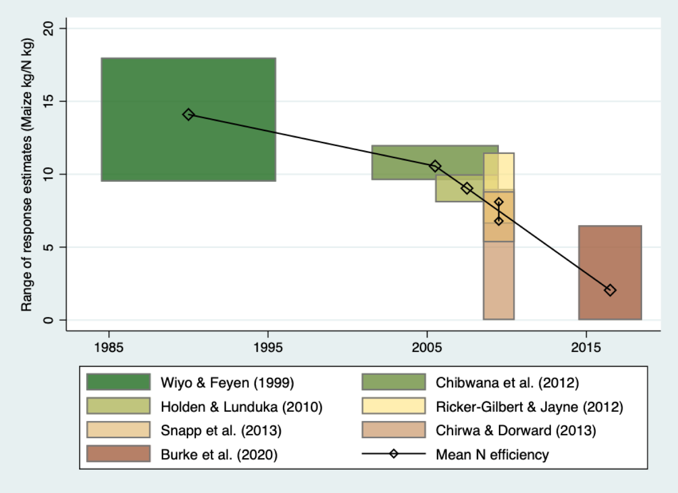
Why previous subsidy programs may have underachieved
Low - possibly declining - maize yield response to nitrogen fertilizer
Yield response to N on farmer-managed fields over time (1984-2018) in Malawi
For more details on each study see Burke et al. (2021), “Sustainable Intensification in Jeopardy: Transdisciplinary Evidence from Malawi” MwAPATA WP 21/07
Notes:
Further, previous subsidy programs have failed to increase the agronomic efficiency of fertilizers
Recent estimates show that farm-level maize yield responses for Malawi are in the range between nil and just over 6kg maize/N kg depending on farm management practices and ecological conditions and 2.6 kg maize/kg N on average (see last bar on the bar graph)
Earlier estimates (from roughly 30 years ago) are as high as 18kg maize/kg N (see first bar in deep green)
However, even the most optimistic estimates of 18kg maize/kg N are way below the regional estimates of between 35 – 37kg maize/kg N
Clearly, yield responses to N fertilizer are low and possibly declining over time.
Thus, raising the agronomic efficiency of nitrogen will be paramount for raising the profitability of using inorganic fertilizers, organic inputs, and improved maize seed
This may not be possible without reforming the subsidy to promote complementary interventions
Next I further lay down the rationale for reforming the subsidy program before presenting the actual reform proposals

Slide 8
The need for reforming the AIP
Already enshrined in the current national budget
The need to focus on dietary and production diversity
Agricultural diversification and commercialization already enshrined in the NAP and NAIP
Recent adoption of the ten-year Malawi Implementation Plan for the long-term MW2063 calls for:
Expressed desire by the His Excellency the State President for a progressive subsidy program
Greater long-term payoffs from investing in infrastructure and social services
Notes:
The national budget recently presented in the National Assembly by the Hon. Minister of Finance already incorporates subsidy reforms
Also, it is common knowledge that maize makes up over half of a typical Malawian diet and dominates farm-level production.
Agricultural policy could be used to change this and promote dietary and production diversity
Further, agricultural diversification and commercialization are already enshrined in the National Agriculture policy and the National Agriculture Investment Plan
Moreover, the recent adoption of MW2063 reinforces the need to reform agricultural programming; and to free resources to accommodate other interventions in the sector
The drive towards reforms has potentially been made easier for Malawi because of the expressed desire by His Excellency the State President to reform the subsidy program to make it more progressive
Finally, studies in India and elsewhere have shown that there are greater and far reaching payoffs from investing in economic infrastructure and social services than subsidies
We therefore propose a number of reforms that government can implement in the short-, medium- and long-term.
Our desire is to have government, and the rest of this forum, start deliberating these proposals and conduct further engagements beyond this event, to work out the modalities and/or the feasibility of implementing them successfully

Slide 9
Short-term Interventions (1 – 5 years)
Target productive resource poor farmers
Add soil health and land management as part of AIP to maximize returns
Introduce inbuilt flexibility and expand input zoning
Strengthen Agricultural Research and Development (R&D) and Agricultural Extension services
Adopt bidirectional extension and learning practices
Improve the general on-farm management practices on smallholder farms
Notes:
In the short-term, a period of 1 to 5 years, subsidies will likely continue having a role in the country's agriculture sector, given their popularity.
However, this does not preclude reforming them into a smarter, and more targeted program with inbuilt flexibility or that expands the zoning of inputs as has been the case with the livestock component of the subsidy program
Also, due to the pervasiveness of extractive farming practices, such as, continuous cropping ‒ no rotation, no fallowing, and overreliance on inorganic fertilizers, Malawi will need to deliberately start incorporating a package of practices and improved technologies to enhance soil fertility and conservation and improve maize response rates to N fertilizer
Examples of such interventions include, promotion of crops that utilize the whole soil profile (top and sub-soil) and provide vegetative top cover for the rest of the dry season or rebuild soil organic carbon
Research has shown that crops respond better to inorganic fertilizers in soils with high SOC
Relatedly, recruiting more researchers and reducing the farmer to extension worker ratio (currently estimated at between 2,500 and 3,000) would be a critical ingredient in revamping the current public R&D and extension services.
An analysis of the expenditure on previous subsidy programs suggests that with about one third of the proposed spending for the 2021/22 AIP, the government could have added 10 research officers at Chitedze Research Station, recruited and trained more than 4,000 extension officers, equipped each officer with a new motorcycle, and provided the fuel and funds to operate it as well as everything needed to run a demonstration plot for improved management.
This would more than triple the governments current research and extension capacities.
In the medium-term, we would like to propose that …….

Slide 10
Medium-term Interventions (5 - 10 years)
Invest more in public infrastructure (e.g., roads, railway, electricity, etc.)
Invest more in social services (e.g., health, education, nutrition, etc.)
Promote dietary diversity through agricultural policy
Promote public-private-partnerships that improve and sustain the country's food security status, wherever feasible
Notes:
.,… government should consider investing more in economic infrastructure (e.g., road, railway lines, electricity, etc.,) and social services (health, education, nutrition, etc.,)
Because studies from India and elsewhere have consistently shown that investing in public infrastructure provide greater long-lasting and widespread payoffs for food security and poverty reduction than sole focus on agricultural subsidies.
Similarly, investing in education, especially in skills development and critical thinking, raises off and on farm labour productivity in the long-run
This is feasible in Malawi, our simulation shows that the cost of just 3.25 average years of the FISP, could have added nearly 9,000 classrooms to existing primary schools, built nearly 500 all-new primary schools, or 130 all-new secondary schools or a new basic science learning laboratory could be built at every single secondary school in Malawi
As already said, these proposals should not mean to say that government should abolish the subsidy program but resolve the design and implementation issues while also aligning investments in economic infrastructure and social services to the subsidy program
We have already talked about the role of policy in promoting dietary and production diversity
And then on the last point, PPP could come in the form of government working with private sector institutions with capacity to produce for the Strategic Grain Reserves (SGRs) to sustain food availability and accessibility by all.
However, to the best of our knowledge, this proposal is an untested and vulnerable approach for Malawi that would require transparent rules and procurement practices, and independent oversight
Lastly, on the recent proposal by government to import fertilizers directly from manufacturers, we believe the decision is mostly certainly going to be a double-edged sword in the sense that it may reduce the landing cost of fertilizers depending on how fertilizer logistics are handled by government agencies
However, the long-term ramifications on the private sector are huge if government does not find a way of involving the private sector, somehow.
Also, it risks delivering fertilizers to farmers late
In the long-run ….

Slide 11
Long-term Interventions (10 years and on)
Explore the possibility of manufacturing some of the fertilizers locally
Anchor the reforms on a consistent, coherent, and enabling policy environment
Increase farmers land tenure rights
Streamline the regulatory barriers inhibiting commodity markets
Increase investments in irrigation to improve water control
Notes:
…… it may be sensible to explore the possibility of producing fertilizers locally, if this can be more cost effective than importing, to reduce the country’s vulnerability to volatile global fertilizer markets
However, it is not immediately apparent that this would be cost effective; the country would still rely on imported fertilizer production inputs and be required to generate a great deal of energy to convert atmospheric nitrogen into fertilizer
Similarly, the country will need to adopt a more transparent, rules-based, and predictable maize marketing and trade policies to reduce the degree of maize price uncertainty and promote greater private investment in agricultural markets.
And to conclude ……

Slide 12
Conclusions
Redesign and diversify the subsidy program to sustain growth
Soil fertility and conservation interventions may raise the productivity of subsidized inputs
Streamline and make the subsidy program flexible and cost-effective
Investing in infrastructure and social services has better long-term pay-offs than subsidies
Notes:
We believe this is an opportune time to redesign and diversify the subsidy program to sustain growth
Integrate soil fertility and conservation interventions that may raise the agronomic efficiency of N fertilizers and the productivity of subsidized inputs
And serious consider linking investments in subsidies with investments in economic infrastructure and social services to increase prospects of an more diversified and vibrant future economy
I thank you all for your attention

Slide 13
c.Nyondo@mwapata.mw

