Slide 1
OPPORTUNITIES, ISSUES AND OPTIONS FOR COMMERCIALISING THE RICE VALUE CHAIN IN MALAWI
Christone Nyondo, PhD
UCHI ROUNDTABLE EVENT – SUNBIRD CAPITAL HOTEL - LILONGWE
April, 16th, 2026

Slide 2
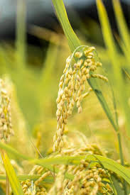
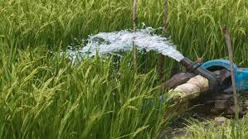
Opportunities in the rice value chain [1]
Rice is the second most important staple and cash crop
Malawi has some of the most popular scented varieties in the region (e.g., Kilombero, Kayanjamalo)
Production and consumption have risen due to changing preferences, higher incomes, and expanded cultivation areas.
Institutionally, Malawi has a specialized rice research institute (i.e., Lifuwu Research Station)
  leads breeding and release of new rice varieties
  leads the production of early generation seed
  Hosts a semi-autonomous SSU that handles seed certification and quality control.
  Hosts a commercial seed multiplication association

Slide 3
Opportunities in the rice value chain [2]
Malawi boasts many agroecological zones where it can be grown
  along the Lake Malawi belt (Karonga, Nkhatabay, Nkhotakota, Salima)
  the Shire valley (Chikwawa & Nsanje)
  Lake Chilwa basin (Zomba, Machinga, Phalombe)
  Bwanje valley (Ntcheu)
  Dambo wetlands (Mzimba, Mchinji, Lilongwe rural, & Chitipa)
  Upland areas (new and expanding).

Slide 4
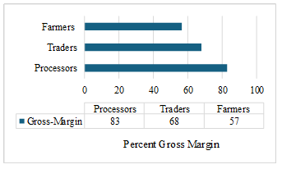
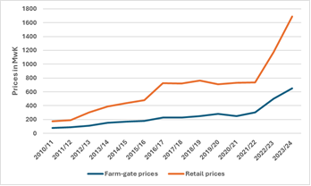

Key issues for commercializing the rice value chain [1]
Rice is profitable across the value chain, but profitability increases significantly with value addition.
Estimated gross margins across the nodes of the value chain | Estimated farmgate and retail prices over the 2011 – 2024 period
Source: Survey data
Source: AMIS and WFP

Slide 5
Key issues for commercializing the rice value chain [2]
Rice trade accounts for a small share of Malawi’s exports, despite the country having a comparative advantage in rice relative to international benchmarks
The opportunity is not just about growing rice, but transforming rice into a competitive export and agro-processing industry that captures more value domestically and regionally.
Source: https://oec.world/en/profile/bilateral-product/rice/reporter/mwi?selector1151id=2016

Slide 6
Key issues for commercializing the rice value chain [3]
Rice trade accounts for a small share of Malawi’s exports, despite the country having a comparative advantage in rice relative to international benchmarks
The opportunity is not just about growing rice, but transforming rice into a competitive export and agro-processing industry that captures more value domestically and regionally.
Source: Computations based on the ITC dataset

Slide 7
Challenges in the rice value chain [1]
Weak seed systems
Lack of a viable certified seed market for rice (rice is self-pollinated and easily recyclable)
Chronic seed shortages, rampant recycling of grain (seed production is centralized & uncoordinated)
Rudimentary production systems
About 85% of Malawi’s rice is rainfed (5% irrigated, 10% upland rice)
Large yield gaps (potential yield 7MT/Ha, Apparent yield – 1.8 MT/Ha farm-level, 4MT/Ha irrigated)
Poor stakeholder coordination
Supply-demand imbalances (i.e., Processors struggle to get paddy rice for milling, while producers lack markets)
Processors mainly purchase milled rice and add value through destoning, grading, and packaging.
Susceptible to climate shocks
Low diffusion of improved varieties (Kilombero & Super Faya are water-intensive and late-maturing)
Poor post-harvest handling, unspecialized milling, and adulteration reduce rice quality – a key driver of prices

Slide 8
Challenges in the rice value chain [2]
Weak technical services
Inadequate field officers, across irrigation schemes, that are specialized in rice production
Low policy prioritisation
Rice ranks low in Malawi’s policy priorities - is weakly reflected in national policies and strategies, including NES-II.
Rice has under-resourced research and seed systems
Lack of structured markets
Rice markets are dominated by vendors – only about 10% sell to structured markets
Insufficient value addition and processing
Weak research-extension linkages

Slide 9
Proposed policy recommendations
  Strengthen seed systems: Decentralize seed production beyond Lifuwu to improve availability and adoption.
  Strengthen extension support: Facilitate the retooling of extension workers assigned to rice schemes
  Enhance value addition: Promote the right investment in small-scale processing and market access.
  Policy alignment: Integrate rice into national development plans and flagship programs.
  Strengthen stakeholder coordination: Better investment is needed to strengthen producer-processor linkages
Notes:
Limited specialised extension services hinder the adoption of improved technologies and production approaches, such as the Sustainable Rice Intensification (SRI) system.

Slide 10
c.nyondo@mwapata.mw

