Slide 1
Commercialisation and Investment Options for Banana Value in Malawi
Joyce Minofu
UCHI Roundtable, Capital Hotel, Lilongwe, Malawi
16 April 2026

Slide 2

Presentation Layout
Banana VC Headline
Banana Policy and Development Support
VC deep-dive approach
Banana Market Overview
Banana VC Map and Challenges
Profitability of Banana VC
Proposed Interventions and Investments

Slide 3



Banana Value Chain Headline
Challenge
Despite Malawi’s highly suitable subtropical climatic conditions for banana production, the country still depends on imports to meet demand.
Opportunity
….generate marketable surplus and replace imports
Proposed Solutions
Seed systems reforms
BBTV infield management
Improved access to irrigation facilities
Promote good husbandry practices
Improve policy coordination

Slide 4
Policy and Development Support
Designated as a priority value chain
  National flagship status by Government of Malawi through MoA
  Ranked 3rd most strategic VC for inclusive agricultural transformation under PPVC
  Selected as top 3 VCs for PPVC deep-dive analysis by MoA
  Priority value chain under UCHI-Strengthening Agr. Commercialisation project
Policy support
  Malawi 2063, MIP-1, NAP (2024)
  Dedicated Coordination Office under MoA
Donor Support
  KULIMA, ASWAP-SP, MTENGO, UCHI, AGCOM, OCOP
Notes:
Kutukula Ulimi m’Malawi (KULIMA) program, Agriculture Sector Wide Approach Support Project (ASWAP-SP), and Market Transitions to Enable New Growth Opportunities (MTENGO), One Country One Priority product (OCOP)

Slide 5

Value Chain Deep-dive Approach
Deep-dive approach consolidates existing evidence and stakeholder perspectives to identify actionable policy and investment reforms
Banana analysis is informed by;
  Primary data from the KIIs
  Secondary data (FAOSTAT, International Trade Centre (ITC), APES).

Slide 6
Banana Market Overview
Globally, bananas are produced in over 130 countries
  With India being a major producer
  USA and Ecuador being the leading importer and exporter, respectively
Regionally, Nigeria, Angola, TZ, Kenya, and Rwanda dominate production in Africa.
MW ranks 38th leading producer in the world and 15th in Africa
MW local production (308,316) is less than local demand(324, 315) resulting in a demand gap of 16, 000 tons as of 2025 (Fig 1)
Scaling local production can reduce import dependence, enhance food security, and tap on regional markets

Slide 7
Banana Stakeholders’ Map and Challenges

Slide 8
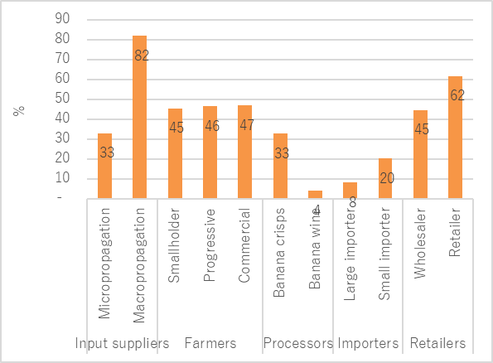
Profitability of Banana Enterprise
Despite the challenges, banana actors make good margins
Macro-propagators earn the highest margins due to increased demand for clean planting materials to control BBTV
Commercial farmers are offered premium prices
Lowest margins for importers due to high transport costs
Processors’ low margins due to low installed capacity
Estimated gross margins from different actors

Slide 9
Proposed Interventions and Investments to Commercialize the Banana VC
Formalize the banana seed systems by mapping out macro-propagators and distributers and developing a commercial model for producing and distributing clean suckers
Improve the infield management of the BBTV through by-laws and biosafety measures
Improve access to irrigation by providing subsidies, concessional financing, or shared community irrigation schemes
Promote good husbandry practices i.e proper site selection, efficient water use, plant density
Encourage a collaborative farmer support model, especially in technical service delivery
Enhance post-harvest handling in progressive farmer groups by strengthening off-taker arrangements, aggregation centrers and information sharing platform
Improve policy coordination and flush out policy inconsistencies
Enhance market access for hard-to-reach areas
Notes:
Kutukula Ulimi m’Malawi (KULIMA) program, Agriculture Sector Wide Approach Support Project (ASWAP-SP), and Market Transitions to Enable New Growth Opportunities (MTENGO), One Country One Priority product (OCOP)

Slide 10


Acknowledgements

Slide 11
j.minofu@mwapata.mw

