Slide 1




Data Symposium on Fertiliser and Soil Health
From Data to Action: Shaping the 10-year action plan for Agricultural Prosperity through Fertilizer insights
Presented by:
Mbawaka Phiri, Fertilizer Market Analyst, IFDC/AfricaFertilizer
October 10th, 2024 || Lilongwe, Malawi

Slide 2


What we do..
Fertilizer statistics i.e. production, trade, use by crop analysis/national and regional surveys
Monitoring and Early warning tools, dashboards, web-based tools
Government and private sector strategy formulation, market intelligence
Fertilizer market analysis and advisory
Donor and commercial projects implementation

Slide 3
Motivation for data collection
To support the growth and development of competitive fertilizer markets
by providing timely and accurate data for policy and business decisioning
with the aim of stimulating actionable insights through the implementation
of continental, regional and national fertilizer policies within Africa’s
fertilizer sector
Main data activities: Fertilizer statistics/analytics, Monitoring and Early
warning dashboards, web-based tools, Gvmnt & Private sector strategy
formulation, market advisory and assessment for fertilizer investors

Slide 4
Fertilizer data collection, 14 years on..
1st Summit
AfricaFertilizer
Data scaleup and visualization
Growth phase/ Beyond
>The 1st AfricaFertilizer Summit in Abuja
>Started tracking 4 countries
>1st organization tracking fertilizer data for Africa
>FTWG model setup
>1⁰ source of truth on fertilizer data in Africa
>20 countries tracked (and growing)
>12% revenue private sector funding
>CAADP focal point on fertilizer indicator
>Crisis monitoring tool expansion
>Revenue injection by GF
>Visualization of our data for wider reach
>3 country dashboards created
>First market advisory contract with Maaden
2009
2017
2021
2006
2010
2018
2024+
Conceptualization
Market data maturity
Acceleration/Nigeria Private Sector
>AfricaFertilizer was conceptualized by IFDC and IFA
>14 countries tracked
> Data granularity enhanced
> FTWG’s conducted annually for 14 countries
>5 more country dashboards
>First monitoring tool for crisis developed
>Data work expanded to 18 countries
>1st private sector funding model rolled-out

Slide 5
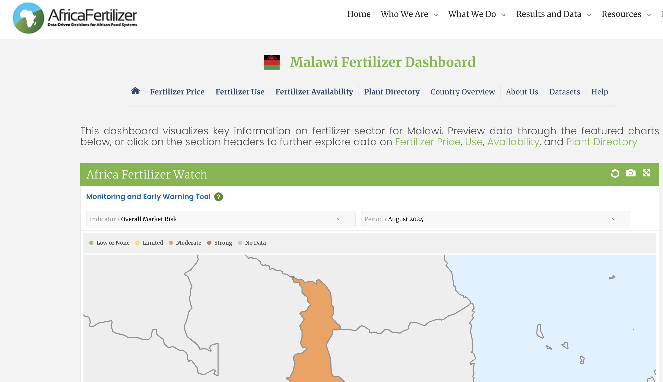
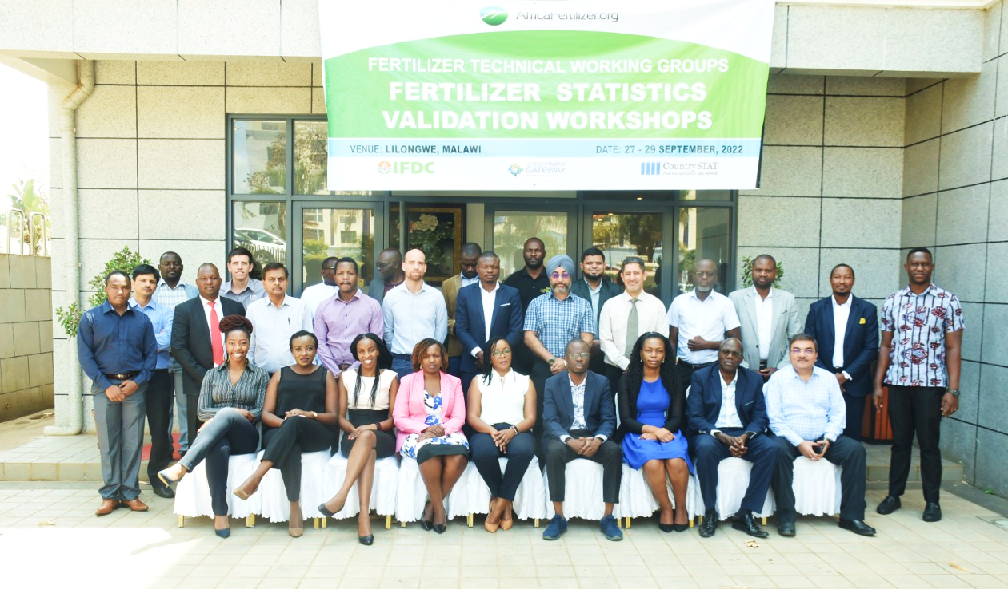
Our work in Malawi
FTWG meetings/Excerpt of Malawi dashboard
Institutionalized a fertilizer technical working group (FWTG) that validates
fertilizer statistics for the country and could do the same for the action plan
Developed a country dashboard for all fertilizer data
(https://viz.africafertilizer.org/#/malawi/home) (Do a brief demo of the DB)

Slide 6
Our work in Malawi cont..
Realtime insights for policy and business decisioning (AIP, Procurement
plans)
Market transparency for global suppliers looking to participate/back bids
for national tenders
Crisis management, by highlighting the forex issues, we were able to work
with international interventions during recent crisis e.g. OCP donation, World
food program etc.
Cross border trade discussions/validation with neighboring countries of
Zambia, Mozambique, Tanzania and Zimbabwe in streamlining trade flows

Slide 7
Major wins in Africa
Data used by the UNGCRG during the fertilizer crisis from 2022/23
resulting in allocations in Ghana/Malawi through SUSTAIN Africa
Data used in the fertilizer sector review for domestication of the 10 year
Action plan in Nigeria, Ghana, Burkina Faso and Mali in 2024
Data used in the 4th and now 5th BR CAADP report under the AUC
Data democratization in 20 countries in Africa opening the continent to
Investors in the fertilizer space
Nigeria private sector partnership resulting in market growth and
understanding of the blending market
Cost savings to Ethiopian government of 20Bn Birr through early
procurement by use of market analysis data in 2023/24 season

Slide 8
Challenges faced & lessons learned
Buy-in and consensus building will be paramount to the success of the
10-year action plan domestication guideline with clear roles spelt out for all
parties
Soil health indicators could be adapted from the foundational data on
fertilizers that we have already collected
The existing FTWG, methodology etc. should serve as an existing platform
for validating both fertilizer and soil health indicators
A thorough sector review will be required before crafting the national
action plan. IFDC ready to partner with other local entities to do that

Slide 9
Thank you
Please contact us on mphiri@ifdc.org/ snduva@ifdc.org/ info@africafertilizer.org for more details.

