Slide 1
Policy Lessons for Localising the Food Systems Transformation Agenda in Malawi
Dinah T. Salonga, Anderson Gondwe & Levison Chiwaula
Policy Brief Dissemination Workshop
BICC, Lilongwe
22nd January 2026

Slide 2

Introduction
African countries adopted the CAADP in 2003 as policy framework for transforming the agricultural sector
In Malawi, it was embedded into medium and long-term development plans and priorities
Its implementation has faced several challenges
There is consensus that policies require review and strengthening
  To address the emerging challenges such as climate change
The consensus for change is evident in commitments made at recent major summits
  UNFSS 2021; N4G 2021 & AU Kampala Declaration 2025
  Emphasizes the need for food systems transformation
Notes:
CAADP means Comprehensive African Agricultural Development Program
N4G means Nutrition for Growth

Slide 3
Introduction (cont./)
The Kampala Summit endorsed two key documents
  Ten-Year CAADP Strategy and Action Plan (2026–2035)
  Kampala Declaration (Advancing Africa’s Inclusive Agri-food Systems Transformation for Sustainable Economic Growth and Shared Prosperity)
It is important to reflect on the policy and regulatory reforms
  To catalyze Food Systems Transformation (FST)~ all the 5 pathways focus areas
This policy brief informs the localisation of global and regional policy frameworks for the FST in Malawi
Notes:
(1) Ensuring safe and nutritious foods for all (2) shifting to sustainable consumption patterns (3)boosting nature-positive food production (4) advancing equitable livelihood and (5) building resilience to vulnerabilities, shocks and stress.

Slide 4
Methodology
The policy brief used two data sources;
Literature review
  Assess coherence and alignment of key national frameworks related to FST (Mw2063; NAP; NAIP; NMSNP; etc.)
District and central level stakeholders’ consultations
  District: DAECC- both govt & non-state actors in 3 TI districts~ Chikwawa, Dedza & Mzimba
  Central level: NPC; development partners and private sector
Notes:
NMSNP means National Multi-Sector Nutrition Policy
DAECC is District Agriculture Extension Coordinating Committee

Slide 5
Finding 1: Coherence and alignment of agricultural policies
Some policy frameworks and strategies are well aligned and coherent with regional and continental policy frameworks aim to transform food systems
  Mw2063; NAP; NAIP and NMSNP
Significant gaps exist
  NMSNP focuses exclusively on children under five, neglecting other vulnerable groups such as pregnant women and adolescents
  Food waste management, retail marketing, and cold storage management- insufficiently addressed in policy frameworks
  Prioritization of maize production i.e., FISP/AIP undermines diversification efforts

Slide 6
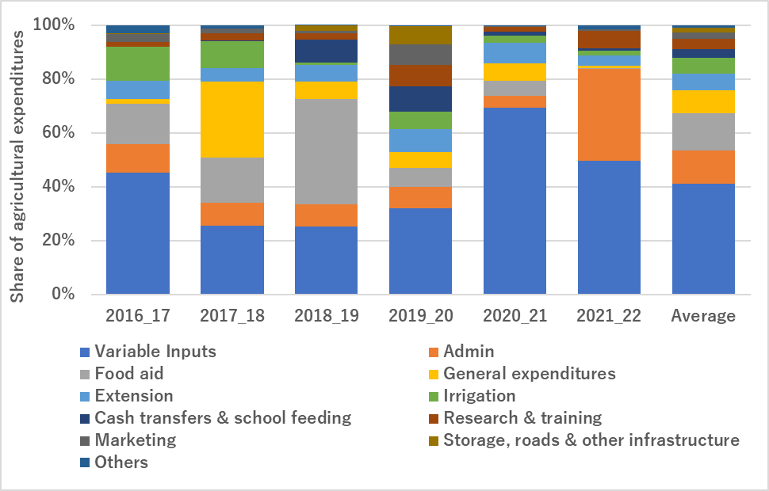
Figure 1: Trends of agricultural resource allocation in public expenditures
Source: World Bank
Notes:
Review and analysis of public expenditure data from IFMIS indicates that expenditure s have largely emphasized supporting maize through AIP and food aid
The graph indicates that large share of agriculture resources goes to variable costs
These variable costs consist of FISP funds for maize seed and fertilizers
Indicating policy prioritization towards maize production

Slide 7
Finding 2: Weak policy dissemination
Government officials at national and district levels exhibited high awareness of policies
Less awareness at community level reaches ~ frontline staff or farmers
  Lack of implementation or poor communication of key frameworks
High extension workers vacancy rates
Inadequate resources for awareness campaigns
  Constrain dissemination of policies in user-friendly formats.

Slide 8
Finding 3: Limited funding for supporting effective food systems transformation
Persistent lack of sustainable funding at district councils
  Limits implementation of food systems transformation
Limited available resources are donor-driven
  Exposing food systems initiatives to the risk of shifting external priorities, which undermines sustainability and long-term planning
Locally generated resources at the district councils are channeled back to the Treasury
  Leaving districts with little flexibility to fund operations
Constituency Development Funds are largely being politically directed toward roads and bridges.

Slide 9
Finding 4: Lack of meaningful decentralization
Centralized management of district resource limits the role of district councils in food systems transformation.
  Resources include land, tractors, and infrastructure, including residential training centres and dip tanks
  management of critical resources is not yet devolved to DCs
Food systems governance structures and ToRs are not yet developed at DCs
  Leaves a gap in accountability and leadership to implement inter-ministerial integrated FS strategies.

Slide 10
Recommendations
Budget allocations should prioritize initiatives that promote diversification of nutrient-dense crops, livestock & investments
  Research, extension, irrigation, storage, and infrastructure
Need to strengthen the enforcement capacity of food safety and waste management
  Increasing funding and staffing for regulatory bodies
  Establishing designated waste disposal and recycling facilities,
  Scaling awareness campaigns on hazards

Slide 11
Recommendations (cont./)
There is a need to create and fund a clear dissemination strategy
  Availability of user-friendly formats of policies and strategies
There is need to devolve resource management to district councils, strengthening inter-ministerial coordination, and establishing district-level governance structures
  Clear terms of reference for stakeholders

Slide 12

Acknowledgements
This research is funded by the German Federal Ministry for Economic Cooperation and Development (BMZ) and supported by the Deutsche Gesellschaft für Internationale Zusammenarbeit (GIZ) GmbH.

Slide 13
a.gondwe@mwapata.mw
d.salonga@mwapata.mw
l.chiwaula@mwapata.mw

